Slide 1




AGENTIC CLIMATE EARLY WARNING SYSTEM FOR SRI LANKA
Ariwalagan Dhilshan
COBScDS242P-017

Slide 2




Background & Motivation
  Sri Lanka is highly exposed to:
    Monsoon-driven floods
    Seasonal droughts
  Existing practices:
    Often station-level rainfall numbers
    Limited district-level, decision-ready warnings
  Need:
    Multi-day early warning
    District-level risk
    Transparent, adjustable decisions

Slide 3




Research Problem & Questions
  Problem:
    Forecasts alone are not enough for early warning
    Need linkage: Forecast → District Risk → Alert → Explanation
  Key research questions:
    How to forecast precipitation 1–7 days ahead using a station graph?
    How to aggregate station forecasts into district-level features?
    How to model district flood/drought/normal risk with calibrated probabilities?
    How to attach explanations to each alert for operators?

Slide 4


Objectives & Scope
  Objectives:
    Build station-level precipitation forecasting model (P=30, H=1..7)
    Convert station forecasts into district-level rolling features
    Generate flood/drought/normal labels via data-driven thresholds
    Train a calibrated district risk classifier
    Implement autonomous alerting with SHAP-based explanations
  Scope:
    1 – 7 days lead-time warnings
    429 stations → 25 districts
    Full ML-to-decision pipeline

Slide 5


Dataset & Core Files
Dataset
Core Files
  Time period:
    2022-11-11 to 2024-11-11 (T = 732 days)
  Spatial coverage:
    429 weather stations
    25 administrative districts
  V_precip_log1p.csv:
    732 × 429 log1p precipitation matrix
  W_knn10.csv:
    429 × 429 KNN-10 adjacency matrix
  stations.csv:
    station IDs & coordinates
  districts.geojson:
    district boundaries

Slide 6


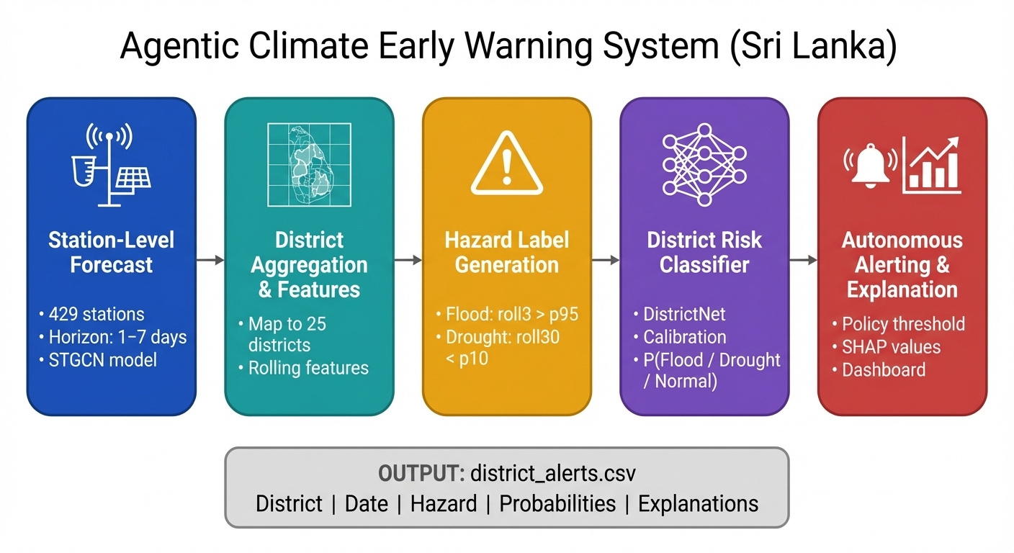
System Workflow

Slide 7


Graph Construction
  Motivation:
    Rainfall correlated across nearby stations
    Need to encode spatial dependencies
  Approach:
    K-nearest neighbors (K=10) based on geographic distance
    Weighted adjacency matrix: W_knn10.csv
    Distance kernel with σ ≈ 136 km (controls influence decay)
  Role:
    Used in every horizon’s STGCN training

Slide 8
Station Forecasting Model
  Problem formulation:
    Input: last P = 30 days of log1p rainfall (V[t−29:t] for all stations)
    Output: rainfall at horizon H days ahead (V[t+H])
  Architecture:
    Temporal convolution → Graph convolution
    Uses W_knn10 to share information across stations
  Training:
    7 separate models (H = 1..7)
    Epochs = 30, batch size = 16, LR = 0.001
    Loss: L1 (MAE), metrics: MAE & RMSE

Slide 9
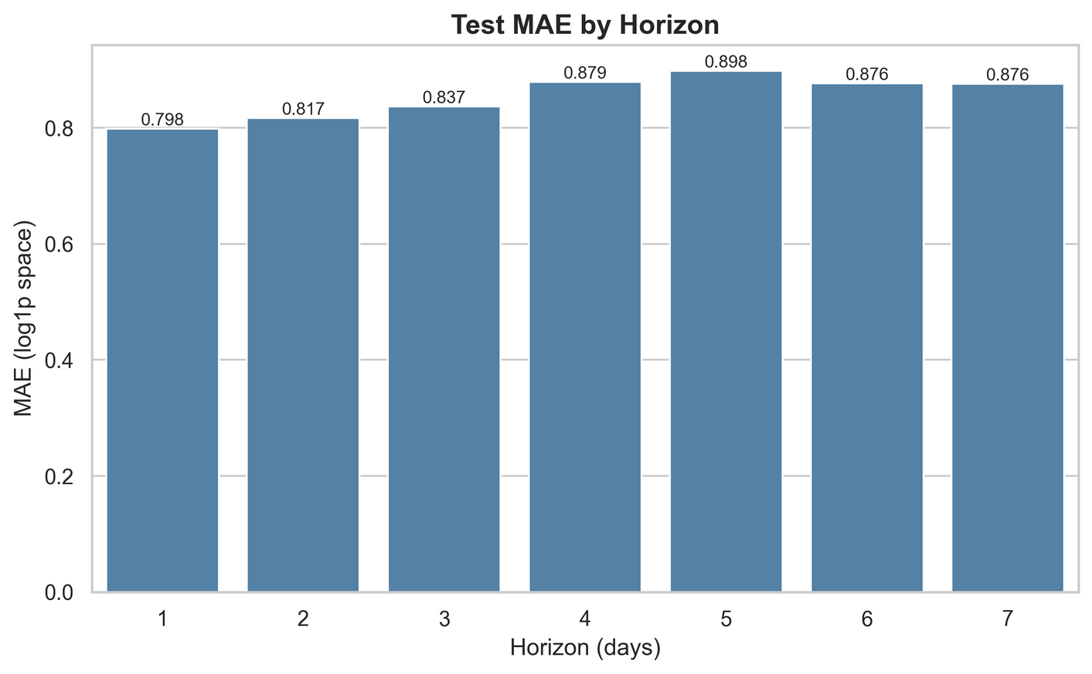
Station Forecasting Results
  Test performance by horizon:
    H=1: MAE 0.7983, RMSE 1.0175
    H=2: MAE 0.8165, RMSE 1.0294
    H=3: MAE 0.8368, RMSE 1.0539
    H=4: MAE 0.8793, RMSE 1.1106
    H=5: MAE 0.8980, RMSE 1.1345
    H=6: MAE 0.8765, RMSE 1.10
    H=7: MAE 0.8763, RMSE 1.0980

Slide 10
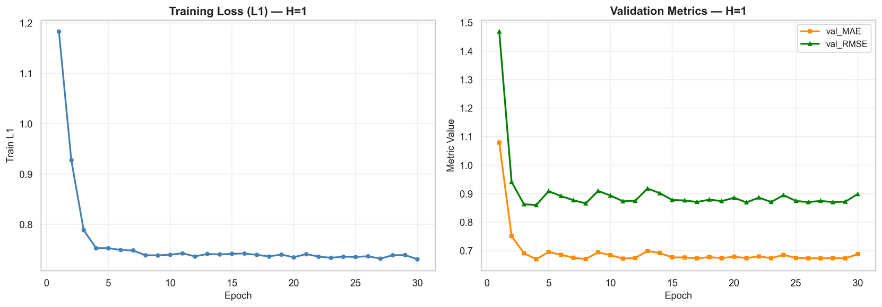
Observations of Forecasting Results
  Errors increase with lead time (expected)
  Skill maintained even at H=7
  Learning curves show stable convergence

Slide 11
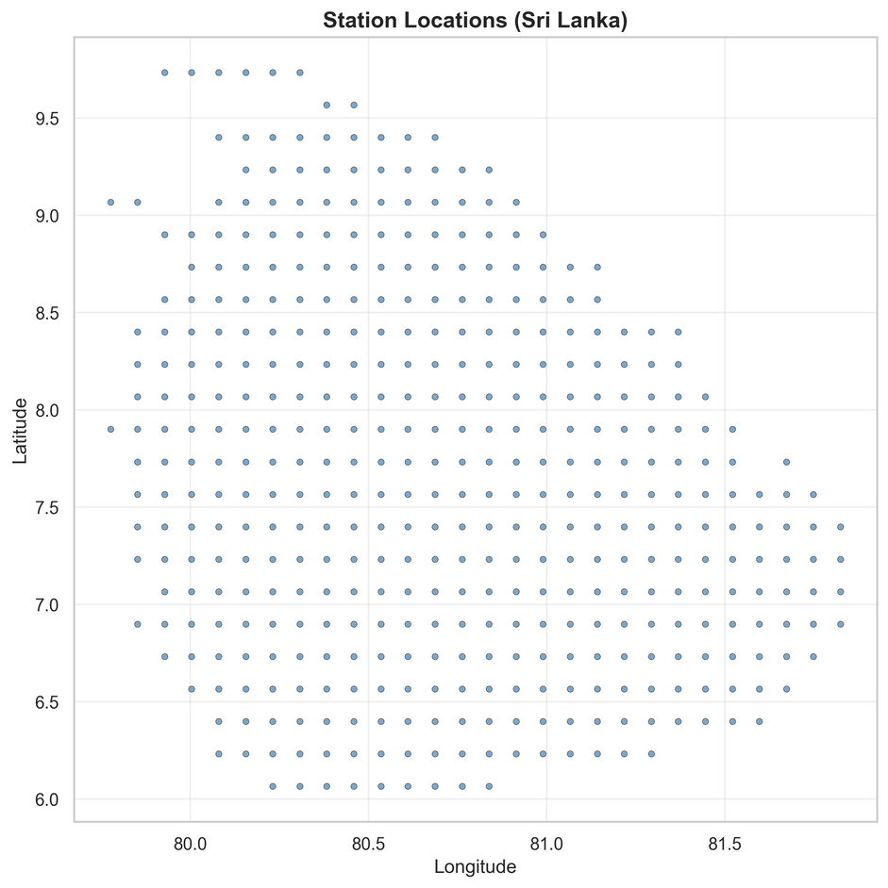
District Aggregation & Feature Engineering
  Mapping:
    Use districts.geojson to assign stations to districts
    429 stations mapped, 3 unmatched (edge cases)
  Aggregation:
    Average station forecasts per district
  Features per district:
    roll3_mm (3-day sum) – short-term accumulation
    roll7_mm (7-day sum)
    roll30_mm (30-day sum) – longer-term deficit
    ypred_mm – next-day predicted rainfall

Slide 12
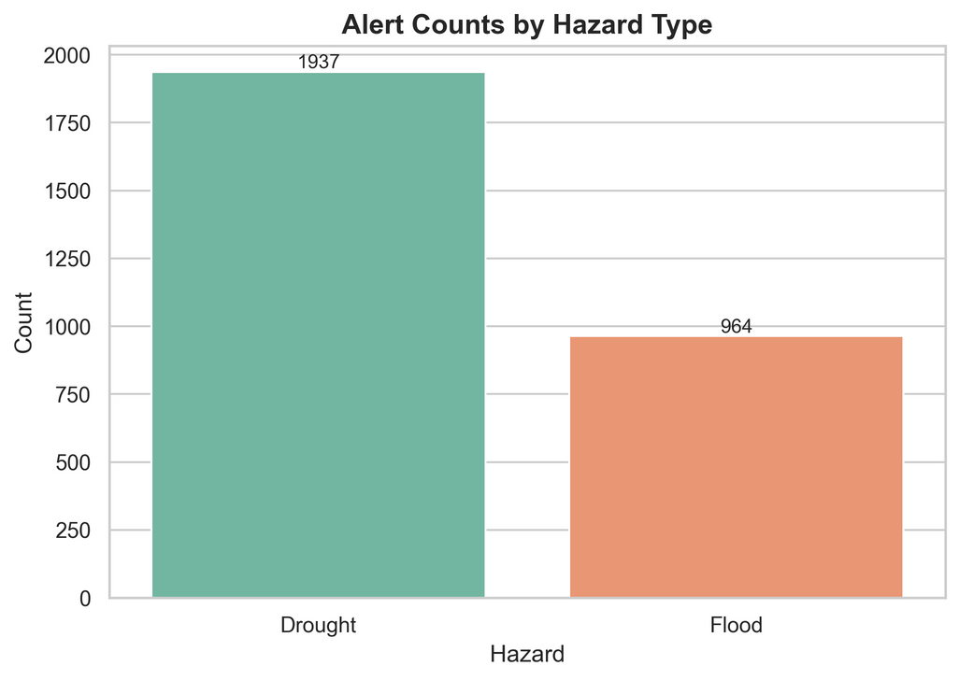
Hazard Labeling
  No ground-truth impact records in dataset
  Data-driven thresholds from district features:
    Flood: roll3_mm > 59.55 mm (95th percentile)
    Drought: roll30_mm < 24.37 mm (10th percentile)
    Normal: otherwise
  Rationale:
    Floods: extreme short-term accumulation
    Droughts: prolonged low rainfall
    Percentiles adapt to local climate

Slide 13
District Risk Classification
  Inputs (4 features):
    roll3_mm, roll7_mm, roll30_mm, ypred_mm
  Architecture:
    Input (4) → Hidden (64, ReLU, dropout 0.2)
    Hidden (64, ReLU, dropout 0.2)
    Output (3) → Softmax (Flood, Drought, Normal)
  Training:
    Loss: Cross-Entropy
    Separate model per horizon (H=1..7)
  Outputs:
    P(Flood), P(Drought), P(Normal)

Slide 14
Probability Calibration
  Problem:
    Neural networks often overconfident → bad for thresholds
  Method:
    Temperature scaling on logits:
      calibrated_probs = softmax(logits / T)
    T learned on validation set (no retraining of main model)
  Results:
    Macro-F1 ≈ 0.9936
    ECE ≈ 0.0026–0.0044
  Meaning:
    High accuracy AND well-calibrated probabilities

Slide 15
Autonomous Alerting Policy
  Policy parameters (policy.json):
    Flood threshold: 0.6
    Drought threshold: 0.6
  Alert logic:
    If P(Flood) > 0.6 → Flood alert
    If P(Drought) > 0.6 → Drought alert
  Alert record fields:
    district, origin_date, target_date, horizon_days
    hazard (Flood/Drought)
    p_flood, p_drought, p_normal
    thresholds
    ypred_mm, roll3_mm, roll7_mm, roll30_mm
    explanation_top_features (SHAP)

Slide 16



Explainability Layer (SHAP)
  Why explain?
    Operators need to know why a warning was triggered
    Builds trust and supports accountability
  Method:
    SHAP KernelExplainer on DistrictNet
    Per-alert feature contributions:
      roll3_mm, roll7_mm, roll30_mm, ypred_mm

Slide 17
Key Contributions
  Technical:
    STGCN-based multi-horizon station forecasting (P=30, H=1–7)
    DistrictNet with calibrated probabilities
    Data-driven hazard labeling with rolling features
    Per-alert SHAP explanations in structured log
  System-level:
    End-to-end pipeline: data → forecast → risk → alert → explanation
    Human-in-the-loop: tunable policy without retraining
    District-level outputs aligned with administrative decisions

Slide 18
Limitations & Future Work
  Limitations:
    Hazard labels based on rainfall, not impact records
    Dataset limited to 2 years (T=732)
    No hydrological variables (river levels, soil moisture)
  Future work:
    Integrate ground-truth disaster data for validation
    Extend dataset to longer time periods
    Add more variables for richer risk modeling
    Deploy and test in real-time with operational feedback

Slide 19
Conclusion
  Built a practical early warning workflow for Sri Lanka:
    Spatio-temporal rainfall forecasting with STGCN
    District-level risk with calibrated probabilities
    Autonomous alerts with SHAP explanations
  Demonstrated:
    Good forecasting performance across horizons
    High classification accuracy (F1 ≈ 0.9936)
    Very low calibration error (ECE ≈ 0.003)
  Impact:
    Moves beyond “just predictions” to actionable, explainable,
    and adjustable early warnings at district level

Slide 20

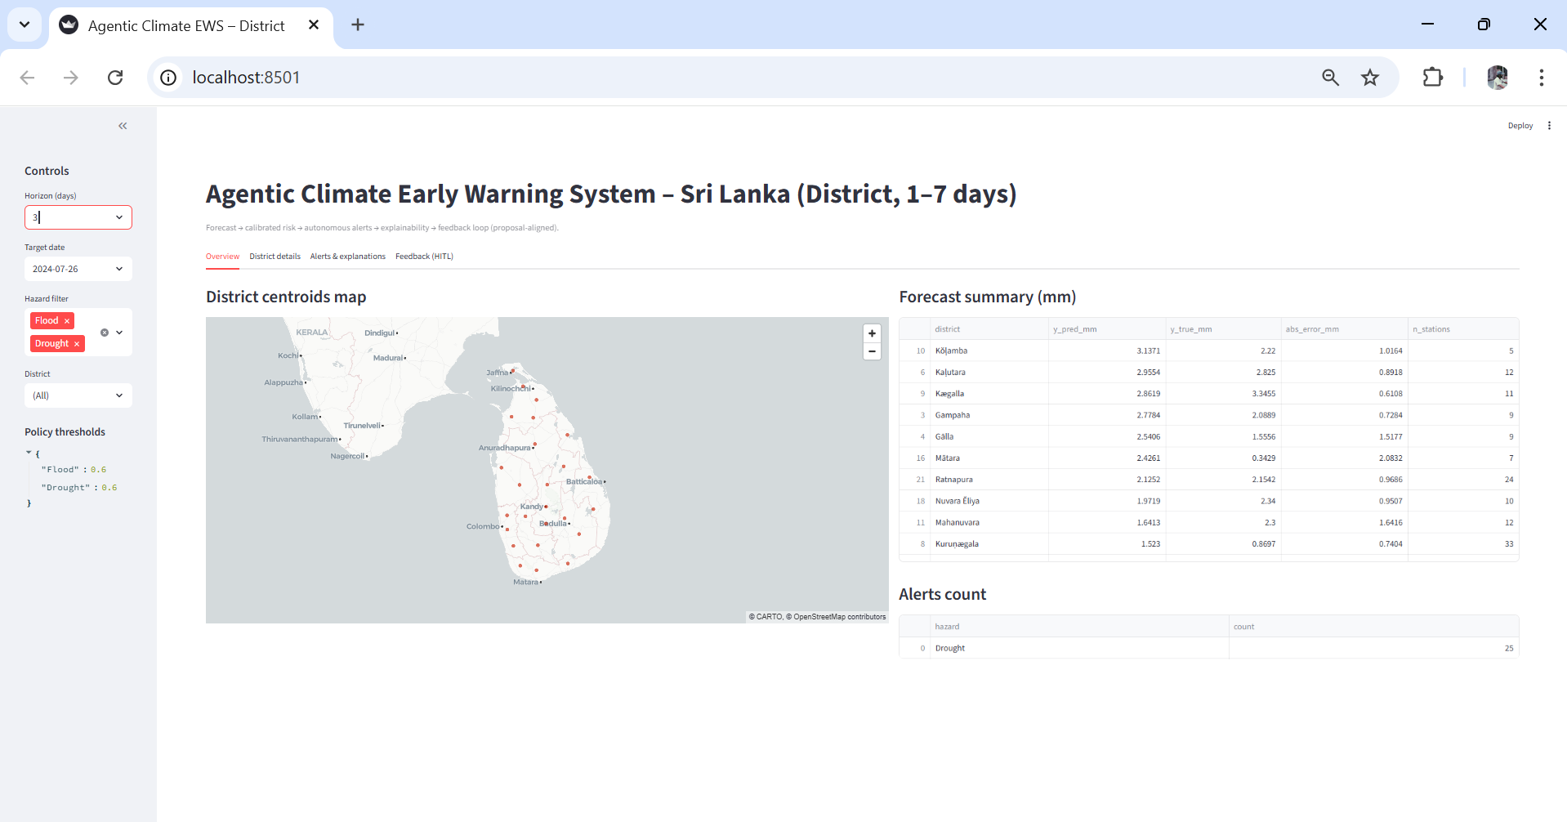

Dashboard

Slide 21
References
  United Nations Office for Disaster Risk Reduction (UNDRR). (2025). Words into action guidelines: Multi-hazard early warning systems. https://www.undrr.org/
  World Meteorological Organization (WMO). (2017). Multi-hazard early warning systems: A checklist. WMO-No. 1206.
  Shi, X., Chen, Z., Wang, H., Yeung, D.-Y., Wong, W., & Woo, W. (2015). Convolutional LSTM network: A machine learning approach for precipitation nowcasting. Advances in Neural Information Processing Systems, 28, 802–810.
  Yu, B., Yin, H., & Zhu, Z. (2018). Spatio-temporal graph convolutional networks: A deep learning framework for traffic forecasting. Proceedings of the 27th International Joint Conference on Artificial Intelligence (IJCAI)
  Capone, V., Casolaro, A., & Camastra, F. (2025). Spatio-temporal prediction using graph neural networks: A survey. Neurocomputing, 643, Article 130400. https://doi.org/10.1016/j.neucom.2025.130400
  Guo, C., Pleiss, G., Sun, Y., & Weinberger, K. Q. (2017). On calibration of modern neural networks. Proceedings of the 34th International Conference on Machine Learning, 70, 1321–1330. https://proceedings.mlr.press/v70/guo17a.html
  Li, B., Ma, J., Yin, K., Xiao, Y., Hsu, C.-W., & Mostafavi, A. (2025). Disaster management in the era of agentic AI systems: A vision for collective human-machine intelligence for augmented resilience (arXiv:2510.16034). arXiv. https://arxiv.org/abs/2510.16034 Early warning of complex climate risk with integrated artificial intelligence (2025).
  Thilakarathne, D., & Premachandra, H. K. A. (2017). Predicting floods in North Central Province of Sri Lanka using machine learning and data mining methods.

Slide 22
THANK YOU
For your attention

